Slide 1
What can we do with TypeScript 2.5?
Presenter: Trong Tran
09 - 2017

Slide 2
Agenda
Introduction JavaScript and ECMAScript
Introduction TypeScript
Get started with TypeScript
What can we do with TypeScript 2.5?
Demo

Slide 3
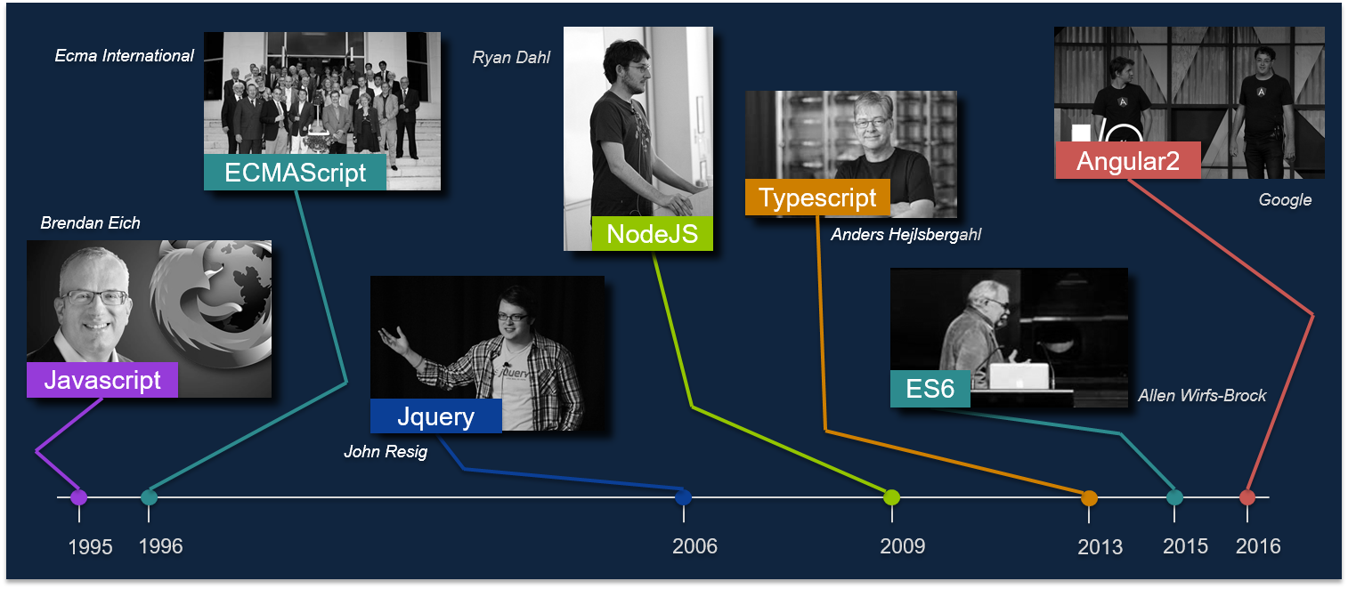
Figure 1 - The milestone of libs/ frameworks invented

Slide 4
1. Introduction JavaScript and ECMAScript

Slide 5
1.1 JavaScript
JavaScript is the programming language, which is use to program the behavior of web pages.
JavaScript code can run locally in a user's browser (rather than on a remote server), the browser can respond to user actions quickly, making an application more responsive. Furthermore, JavaScript code can detect user actions that HTML alone cannot, such as individual keystrokes.
To Browser execute JavaScript code, the browser need to by default included JavaScript engine (also known as JavaScript interpreter or JavaScript implementation) is an interpreter that interprets JavaScript source code and executes the script accordingly.

Slide 6
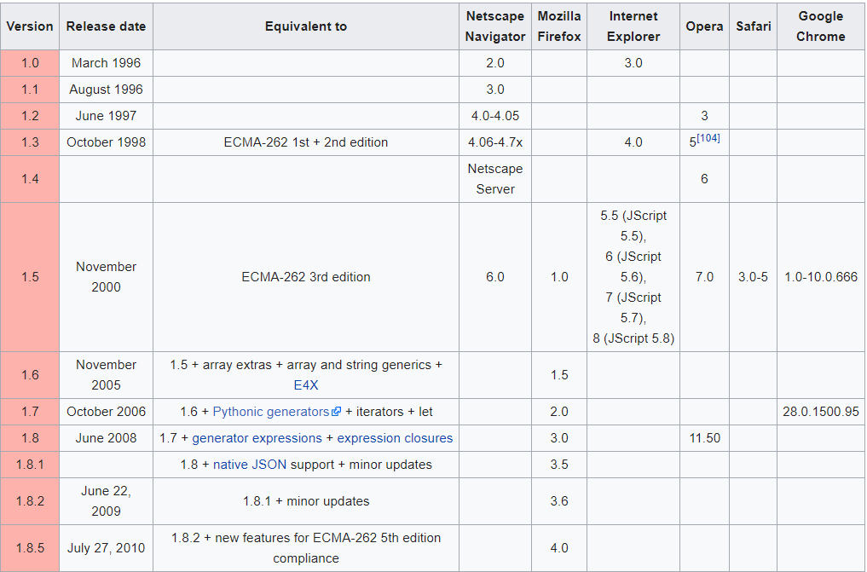
1.1 JavaScript
Figure 2 – Release version history

Slide 7
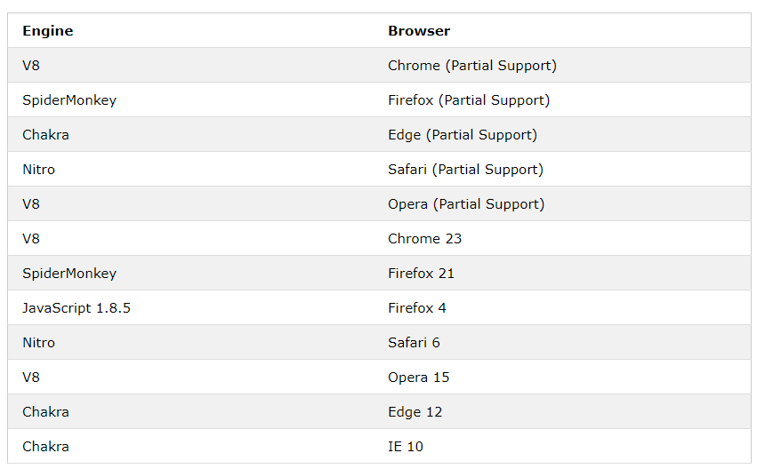
1.1 JavaScript
Figure 3 – Supported JavaScript engine in Browser

Slide 8
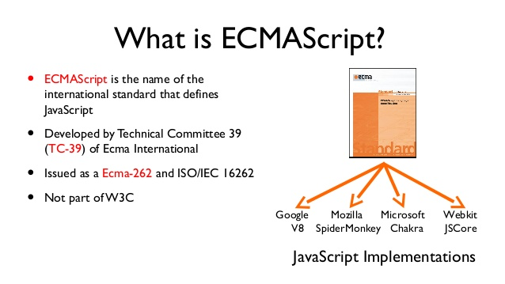
1.2 ECMAScript

Slide 9
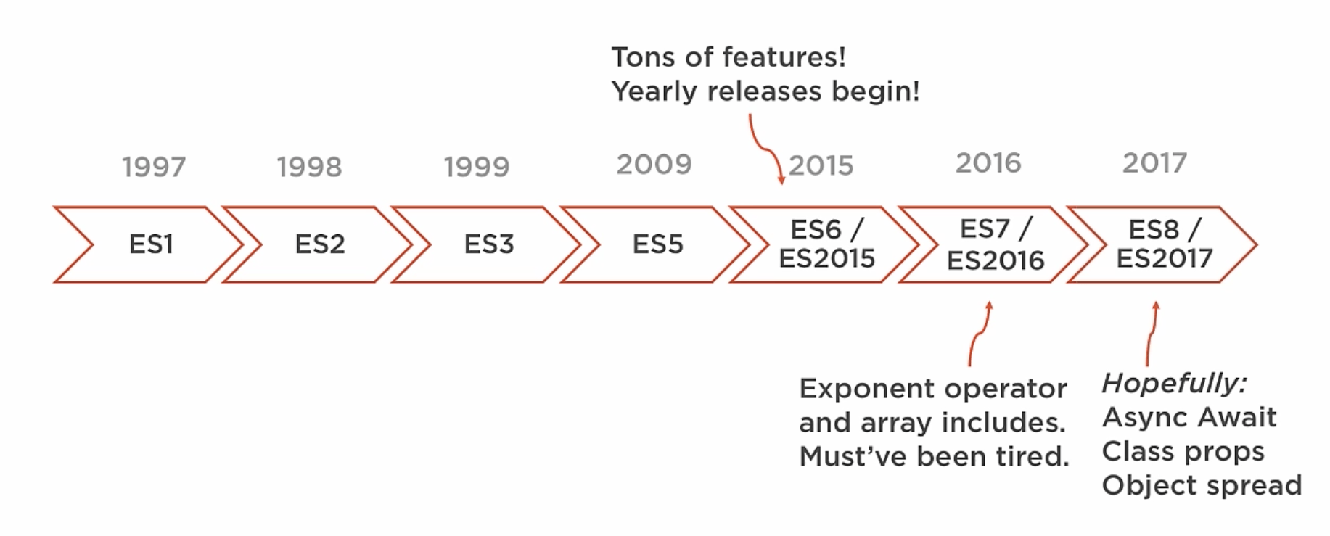
1.2 ECMAScript
Figure 4 – ECMAScript Editions

Slide 10
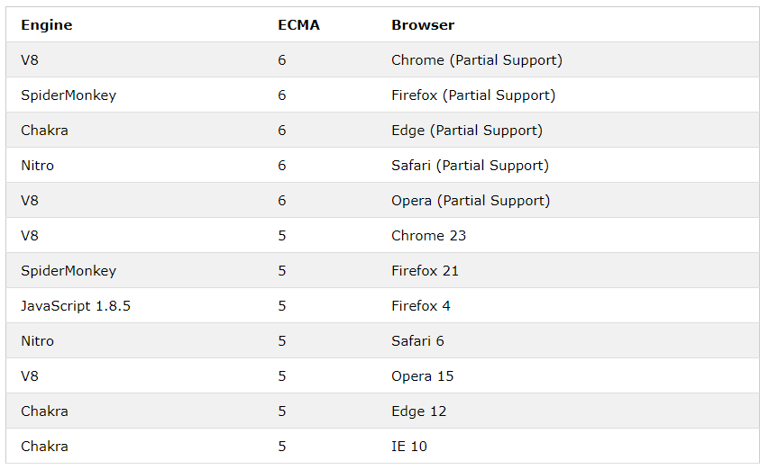
1.2 ECMAScript
Figure 4 – ECMAScript Browser Implementations

Slide 11
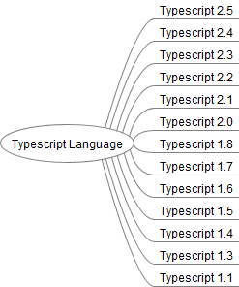
TypeScript Version

